Slide 1
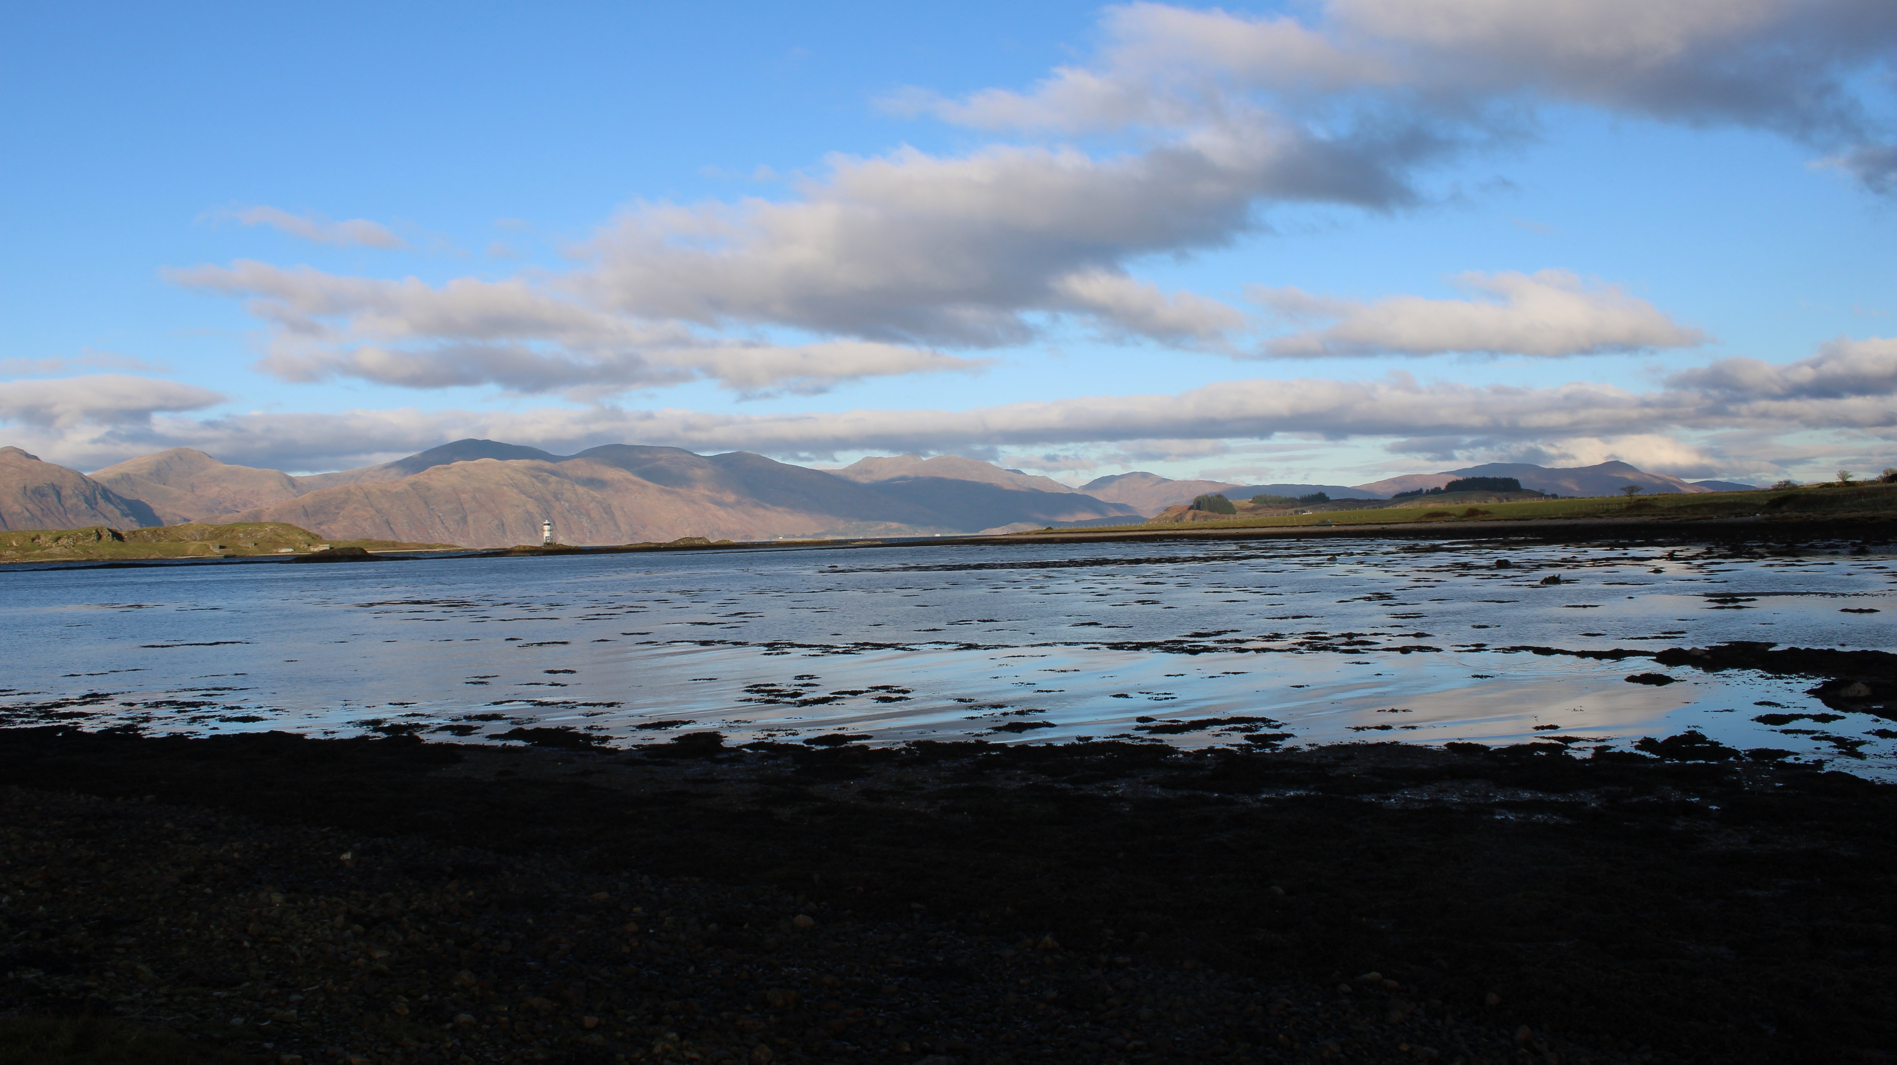
Winter Light 1

Slide 2
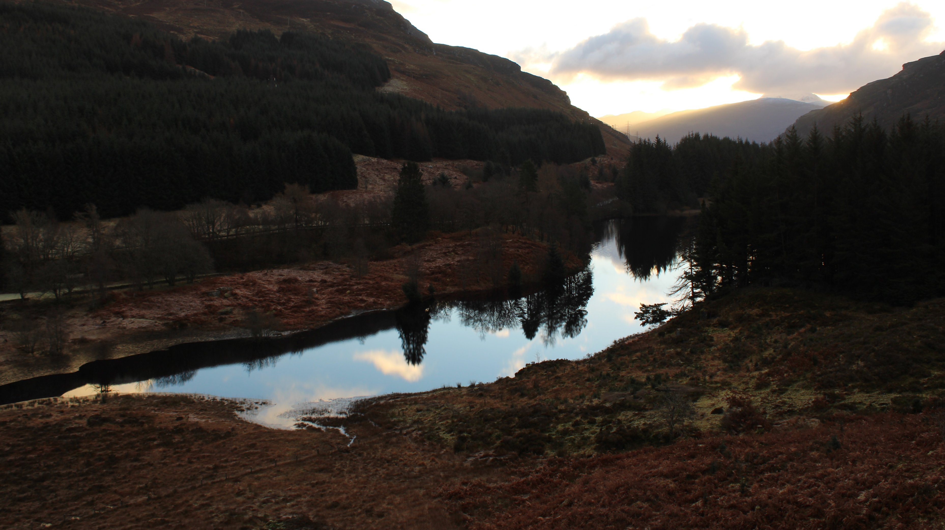
Leader:
As we enter the season of Advent
the hours of daylight are short.
All: Amidst the darkness we look for the
coming of the Light of the World.

Slide 3
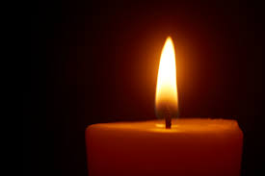
Leader: As a sign of the coming Light of Christ,
we light our first Advent candle.
All: Come, Lord Jesus, come.

